Slide 1

Deep Learning Midterm Project: Predicting NYC Taxi Fares
Using a Feedforward Neural Network for Fare Prediction
Team Ramanjul Reddy Kotlo
koundinya Pidaparthy

Slide 2

Predicting NYC Taxi Fares Using Deep Learning
Developing a machine learning model to accurately predict NYC taxi fares, which can help passengers, drivers, and businesses better estimate costs.
Why This Project ?
Taxi fares in NYC can be affected by numerous factors, such as time of day, distance, and location, making prediction complex.

Slide 3

Dataset and Feature Engineering
Dataset and Collection:
We used 2023 Yellow Taxi Trip Data from NYC’s Taxi and Limousine Commission, which includes trip details like pickup and drop-off times, locations, distances, and fares. After sourcing the data from NYC Open Data, we cleaned it by removing missing or unrealistic values to ensure high quality.
Feature Engineering:
To boost predictive accuracy, we calculated trip duration from pickup and drop-off times, giving the model structured insights into NYC taxi fare trends.
Data Source: https://data.cityofnewyork.us/Transportation/2023-Yellow-Taxi-Trip-Data/4b4i-vvec/about_data

Slide 4
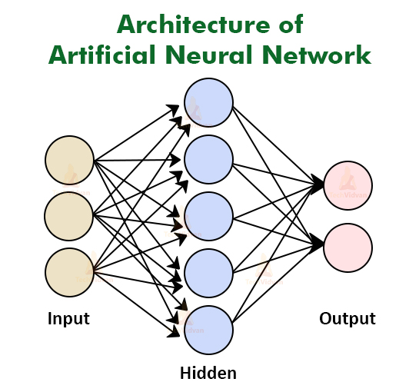


Model Building and Training Process
Model Architecture: We used a Feedforward Neural Network (FNN) for its effectiveness with structured data. The architecture consists of an input layer for features like trip duration, trip distance, and location ID, hidden layers with ReLU activation to learn complex patterns, and an output layer designed for predicting fares.
Training Process: The model was trained using the Adam optimizer and Mean Squared Error (MSE) as the loss function to effectively reduce prediction errors. We fine-tuned key hyperparameters like learning rate and batch size to improve performance. Training took place over multiple epochs, with validation data used to track performance and avoid overfitting. The final model demonstrated strong predictive accuracy.

Slide 5

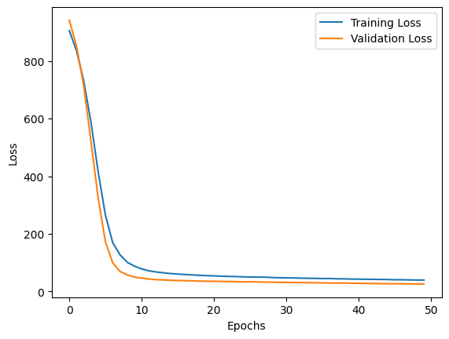

Model Evaluation: Metrics and Insights
Understanding Model Performance:
We evaluated our model using several metrics, including Mean Absolute Error (MAE) and R² score, which allowed us to quantify its accuracy in predicting taxi fares. The R² score of 0.84 indicates that our model successfully explains a significant portion of the variance in fare amounts, reflecting its effectiveness in capturing key patterns from the data.
Learning Insights from Loss Curves:
By analyzing the loss curves during training, we observed a consistent decrease in both training and validation loss, suggesting that the model learned effectively without overfitting. This close alignment between the two losses reinforces our confidence in the model’s generalizability to unseen data, highlighting its potential for practical applications in fare estimation.

Slide 6
Conclusions and Future Directions
Our model for predicting taxi fares in New York City has achieved a solid performance, evidenced by an R² score of 0.84, showing its ability to capture key trends.
Looking ahead, we aim to enhance the model by incorporating additional features like weather data and experimenting with advanced algorithms, ensuring even more accurate fare predictions in the future.

Slide 7

Thank you

